Slide 1
Data Science
What is Data Science?
Data Science is a blend of various tools, algorithms, and machine learning principles with the goal to discover hidden patterns from the raw data.
How is this different from what statisticians have been doing for years?
The answer lies in the difference between explaining and predicting.
So, Data Science is primarily used to make decisions and predictions making use of predictive causal analytics, prescriptive analytics (predictive plus decision science) and machine learning.

Slide 2
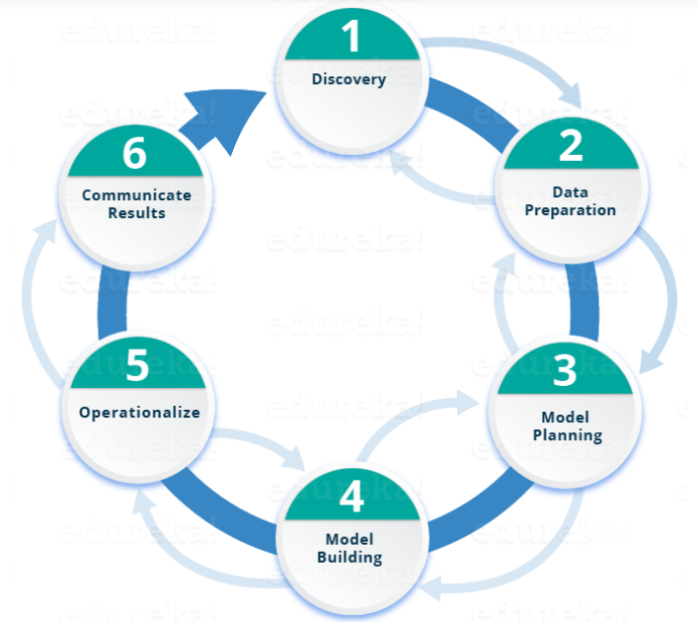
Life Cycle – Data Science

Slide 3
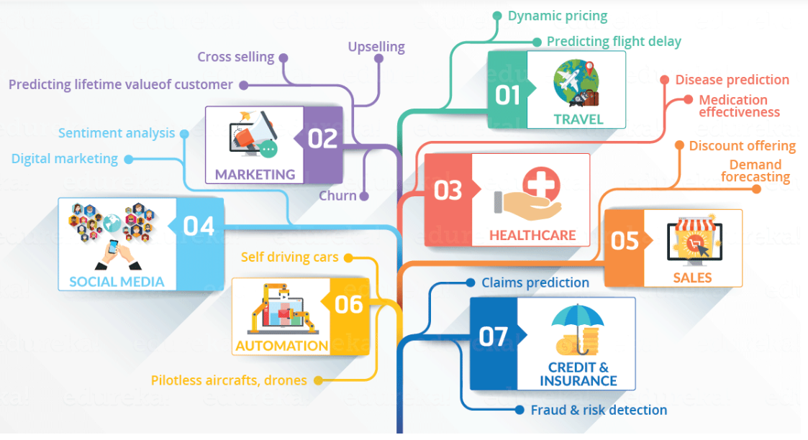

Slide 4
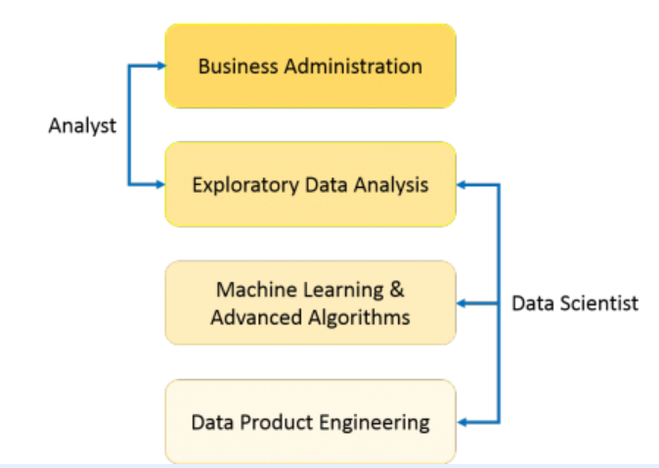
Data Scientist not only does the exploratory analysis to discover insights from it, but also uses various advanced machine learning algorithms to identify the occurrence of a particular event in the future. A Data Scientist will look at the data from many angles, sometimes angles not known earlier.

Slide 5
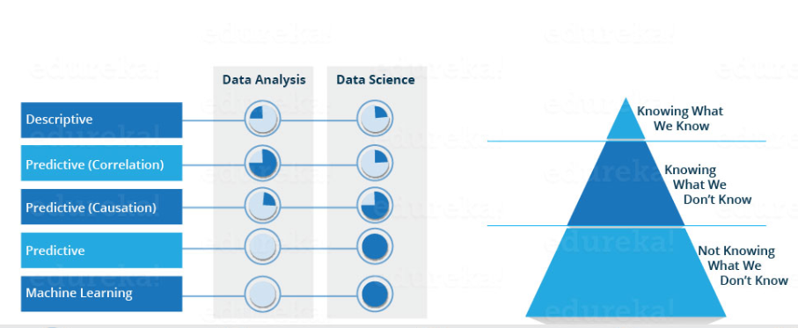
Data Science – Effort chat

Slide 6
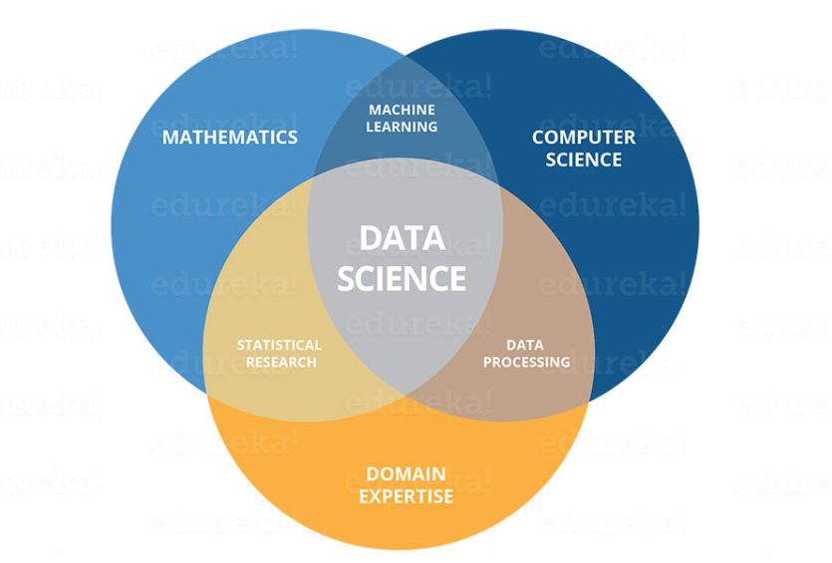

Slide 7
